Slide 2
Exercise Tangaroa 2016
Notes:
Tier 4 national level exercise – all 16 CDEM Groups involved and impacted by the scenario of a regional source tsunami. A Tier 4 exercise, involving all of New Zealand, has not occurred since Exercise Tangaroa in 2010 (ShakeOut has since been renamed as a public education campaign more than an exercise). Since 2010, there has been staff turnover at all levels of the CDEM structure, and implementation of new procedures and systems (such as EMIS). A Tier 4 exercise in 2016 would allow for new or updated procedures and systems to be tested, and provide an opportunity to review recommendations and lessons to be identified from previous exercises.
Name means God of the Sea
The main difference between this exercise and 2010, will be that this one will test the post-impact phase – as shown in the updated logo, demonstrating land inundation.

Slide 3
Aim
To test New Zealand’s arrangements for preparing for, responding to, and recovering from a national tsunami impact.

Slide 4
Objectives
To lead a coordinated interagency response.
To support a coordinated interagency response.
To conduct high-level all of government decision making.
To initiate the transition of response to recovery, including planning and arrangements.
Notes:
The broad objectives cover areas such as leading and supporting a coordinated interagency response; initiating the transition from response to recovery; managing information and delivering effective public information; and business continuity.
These have also been narrowed down into measurable KPIs.

Slide 5
Objectives, continued
To implement business continuity arrangements.
To effectively manage information horizontally and vertically.
To deliver effective public information management.
Notes:
The broad objectives cover areas such as leading and supporting a coordinated interagency response; initiating the transition from response to recovery; managing information and delivering effective public information; and business continuity.
These have also been narrowed down into measurable KPIs.

Slide 6
Objectives, continued
To integrate lessons identified from previous events and exercises in order to engender a culture of continuous improvement.
To further develop collaborative relationships, to enhance interagency knowledge and understanding; creating capability and resilience.
Notes:
The broad objectives cover areas such as leading and supporting a coordinated interagency response; initiating the transition from response to recovery; managing information and delivering effective public information; and business continuity.
These have also been narrowed down into measurable KPIs.

Slide 7
Scenario

Slide 8
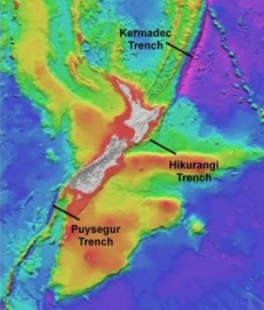
Kermadec Trench - Regional source
Notes:
Regional source scenario agreed - some warning time for most of the country but not a lot. Final location to be determined with GNS. GNS are currently working on a detailed scenario and preparing a report that will outline the expected impacts from this scenario on coastal New Zealand. This will be made available to CDEM Group exercise writers/planners in late February 2016.

Slide 9
Dates

Slide 10
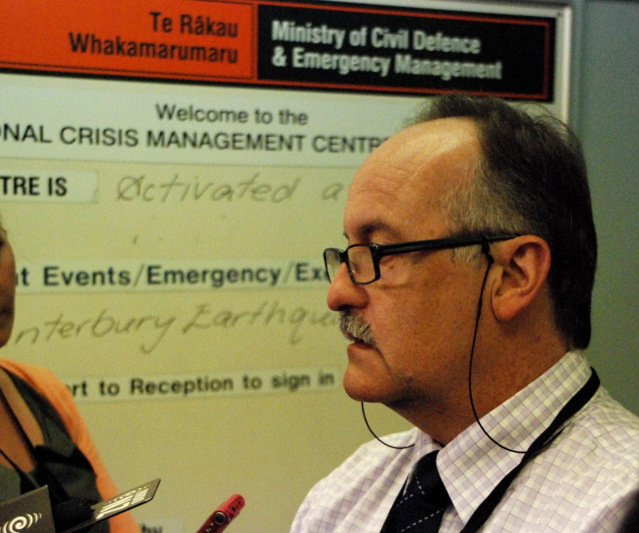
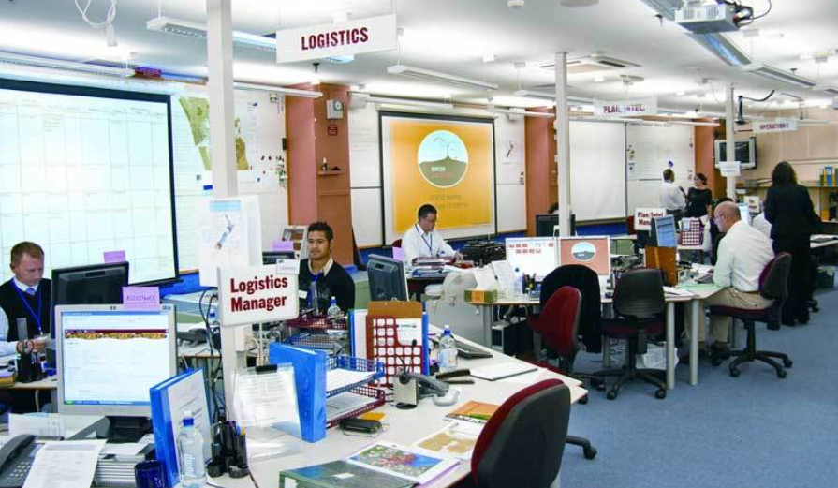
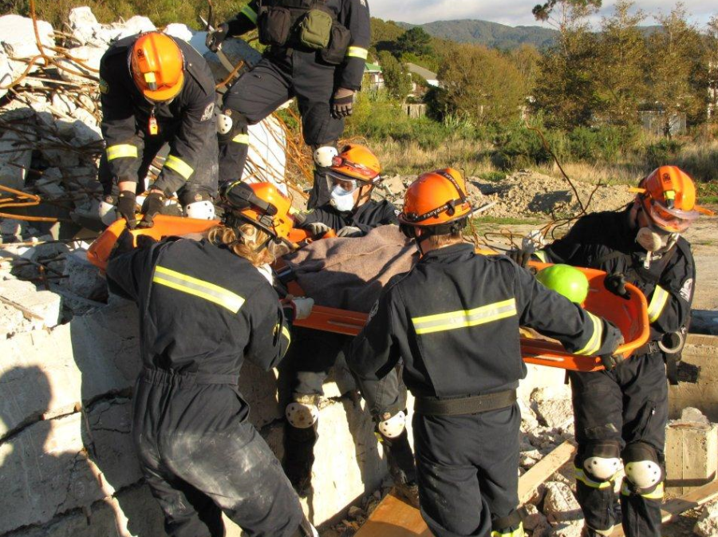
Wed 31 August 2016 – Warning and Impact
Notes:
From initial notification through to tsunami impact.
Day 1 of the exercise will be based on a full scale exercise with activations of the NCMC, ECC and EOC’s around the country.
We will test
National Crisis Management Centre (NCMC), Emergency Coordination Centre (ECC) and Emergency Operations Centre (EOC) activations
Emergency Management Information System (EMIS)
Public Information Management
Evacuations
National Warning System
Declarations
Business continuity
Welfare arrangements
Alerting mechanisms (optional)
Rapid Impact Assessment
Lifeline utilities
NCMC, CDEM Groups and partner agencies together

Slide 11
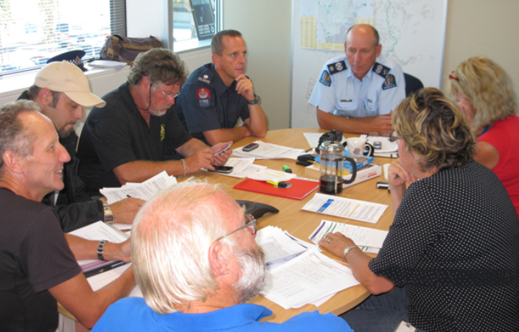
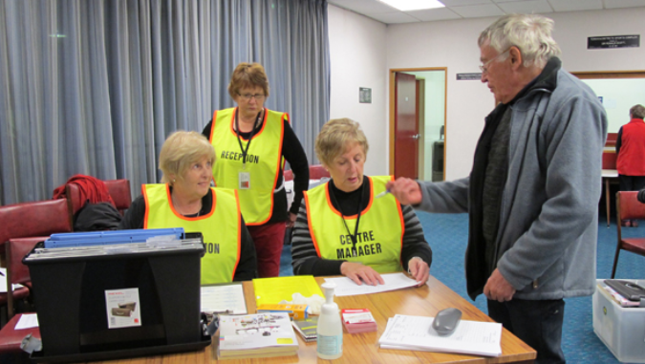
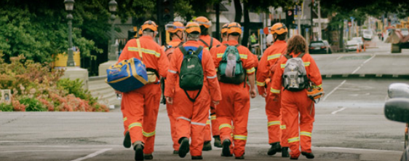
Wed 14 Sept 2016 – Post Impact
Notes:
Day 2 of the exercise falls 2 weeks later and will allow participating agencies to test post impact aspects which may not have been fully tested in day 1 of the exercise.
Includes response elements with a welfare focus.
This might include:
Welfare arrangements
Impact and needs assessments
Post-impact response arrangements
Community response plans (optional)
Evacuations (optional)
CDEM Groups will be able to use the time between Day 1 and Day 2 to ready themselves for further full scale activities or tabletop or workshops to discuss these aspects.

Slide 12
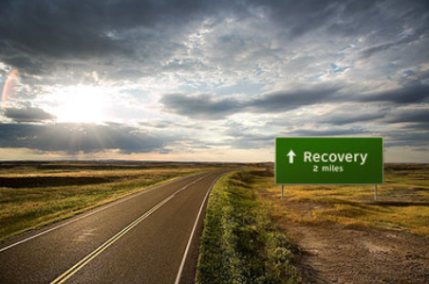
Wed 28 Sept 2016 – Recovery
Notes:
Day 3 of the exercise will be about testing the early elements of recovery, including the transition to recovery and recovery arrangements.
Again, the intervening 2 weeks will allow participants to work towards a workshop to discuss how they will transition from Response to Recovery.

Slide 13
Levels of participation
Category | Description | Example
Full | Agency commits to participating in all exercise activities. | Your agency will fully activate it’s emergency operations centre on day 1 and hold table top workshops on days 2 and 3.
Partial | Agency participates in a specific part of the exercise. | Your agency may partially activate its agency emergency operations centre and only participate on day 1 or have limited staffing on days 2 and 3.
Facilitation | Agency personnel are made available to facilitate exercise injects or enquiries (i.e. a control function). | Your agency will not activate its agency emergency operations centre, but instead have one or more people simulating exercise activities.
Not engaged | Agency not involved in exercise play. | Your agency inputs and outputs will be notional if required (i.e. exercise writers will make up your agency’s input if required). Note: No communication or contact is made with your agency during the exercise.
Notes:
Agencies wishing to participate in the exercise must consider their level of commitment to the exercise and communicate this with the Exercise Planning Team.
The table outlines the four broad levels of participation for Exercise Tangaroa.
It is vital that all agencies inform the Exercise Tangaroa Planning Team of their expected level of participation. This will allow the exercise planning team to give those who participate in the exercise an accurate list of contact details, with Exercise Control substituting for any agency that is not taking part.
A detailed participation form will be distributed to all agencies in February 2016 with responses required no later than 30 April 2016.

Slide 14
Planning structure
Planning Team
The Planning Team is responsible for planning, conducting and evaluating Exercise Tangaroa. Evaluators will report to the Planning Team.
Steering Group
The Steering Group is made up of members from selected national agencies, and is primarily responsible for assisting the Planning Team with the communication and implementation of exercise plans within and across agencies.
Governance Group
The Governance Group maintains oversight of the exercise and reviews reports from the Steering Group. It is made up of members from all 16 CDEM Groups and a member of the NZ Lifelines Committee.
Notes:
PG – Primarily responsible for exercise design, conduct and evaluation.
SG – Primarily responsible for assisting the Planning Group with the communication and implementation of exercise plan within and across agencies.
GG – The Governance Group will act as a “board” for the exercise to ensure it is well run and well governed so that its value can maximised.
Made up of reps from each of the 16 CDEM Groups.
All groups have met – and an ongoing regular meeting schedule for all has been planned.

Slide 15
Communications
Notes:
The Exercise Coordinators will issue regular newsletters to give exercise participants an update on exercise preparations and updates on tsunami work across the country.
Next newsletter due out in February 2016.

Slide 16
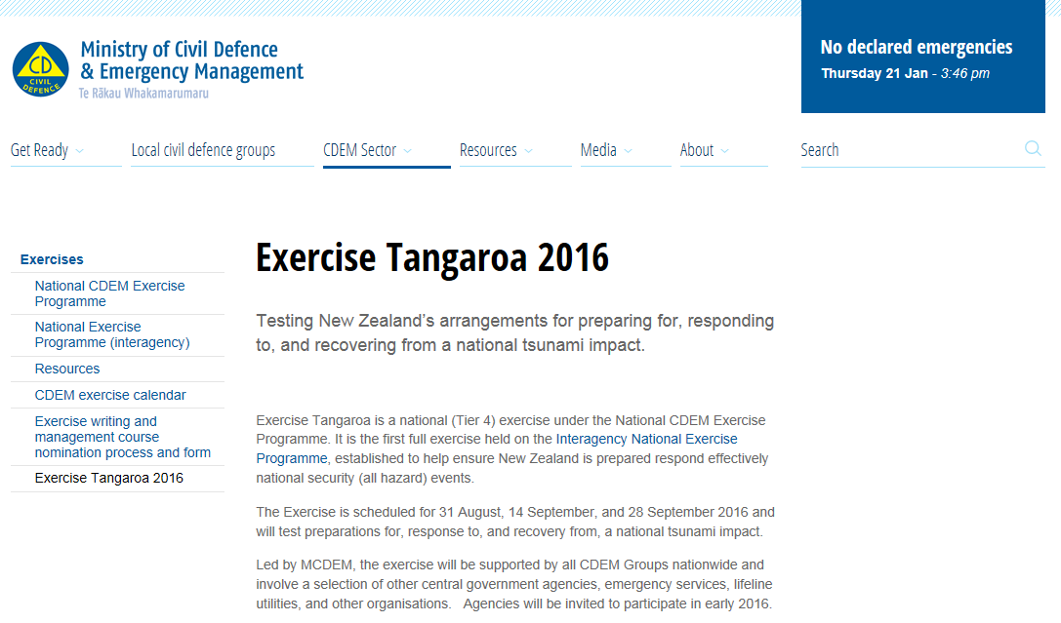
Exercise Tangaroa web page
Notes:
An Exercise Tangaroa page has been created on the MCDEM website – keep an eye out for key exercise documents here.
GNS Science have been commissioned to develop a detailed scenario
The Coordinating Instruction will be issued in early February
A national exercise writers/planners workshop will be held in late February (nominations for CDEM Group reps close in late January) – the GNS Report will be a major input into this discussion
Work is underway on the Exercise Evaluation and Communications plans – likely to be issued in February

Slide 17
Enquiries
Your local REMA
or
Jo Guard or Sara Leighton
Exercise Coordinators
MCDEM
CDEMexercises@dpmc.govt.nz
04 817 8555

